Slide 1

AAFT(Asian Academy of Film and Television)
Practical submission of
Data science processes & algorithm
Presented by Anamika gupta Presented to Ms. Manpreet Bhatiya

Slide 2
Content
Algorithm(definition)
Time Complaxity
Recusrive and Itrative Algorithm
Array operation
If statement,for loop,while loop
Def function, user prompt
Grading systime
Gross salery
Calculator
Factorial and febonaccis sequence
Shorting techniques (merge,quick,devide & conqure
Bubble sort
Insertation sort
Slelection sort
Searching techinques
Decision tree
Heap sort
Greedy algorithm
Knapsack problem
Djikstra’s algorithm
Project 1
Project 2

Slide 3
Algorithm
  A step-by-step procedure or formula for solving a problem or accomplishing a task.
In mathematics and computer science, an algorithm is a finite sequence of rigorous instructions, typically used to solve a class of specific problems or to perform a computation. Algorithms are used as specifications for performing calculations and data processing.

Slide 4
Time Complexity
Understanding Time Complexity
  A measure of the amount of time an algorithm takes to complete as a function of the size of the input.
Computational complexity is a field from computer science which analyzes algorithms based on the amount resources required for running it. The amount of required resources varies based on the input size, so the complexity is generally expressed as a function of n, where n is the size of the input.

Slide 5
Recursive and Iterative Algorithms
Recursive Algorithms
A recursive algorithm is a computational procedure or method that calls itself in order to solve a problem, typically breaking the problem into smaller, similar sub-problems.
Iterative Algorithms
An iterative algorithm is a computational procedure or method that repeatedly executes a set of instructions in a loop, making progress toward solving a problem through repeated iterations. Unlike recursive algorithms.

Slide 6
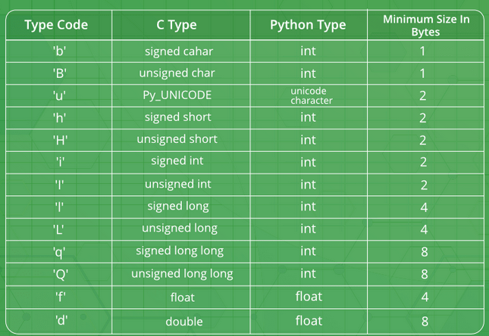
Array Operations
Overview of Arrays
An array is a data structure that stores a collection of elements, each identified by an index or a key,

Slide 7
Control Flow Statements
If Statement
An if statement is a control flow structure in programming that allows the execution of a block of code based on a specified condition. If the condition is true, the code inside the if block is executed; otherwise, it is skipped.
For Loop
A for loop is a control flow statement in programming that allows the repetitive execution of a block of code a specified number of times.
and performs the defined operations during each iteration.
While Loop
A while loop is a control flow statement in programming that repeatedly executes a block of code as long as a specified condition is true.

Slide 8
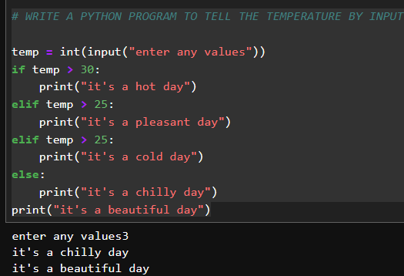
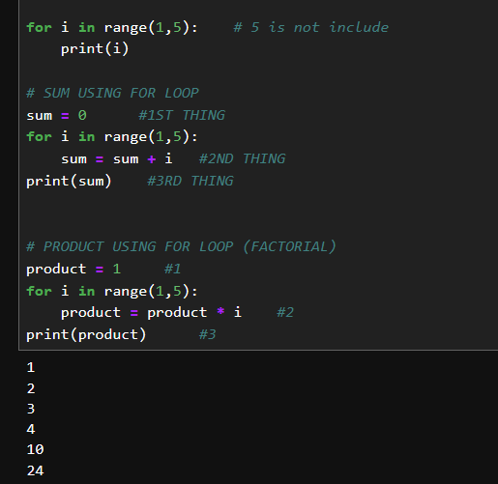
IF-ELSE CODE
FOR LOOPS
WHILE LOOP

Slide 9
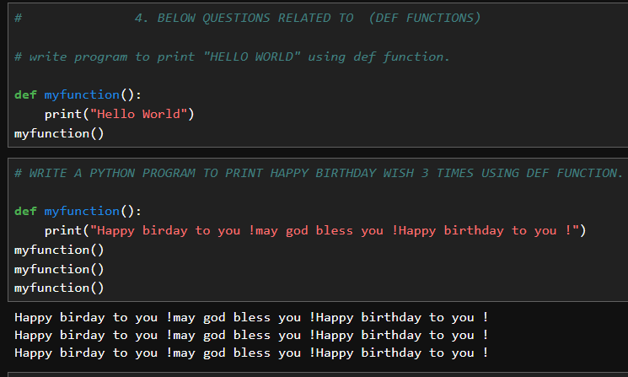
Functions and User Input

Slide 10
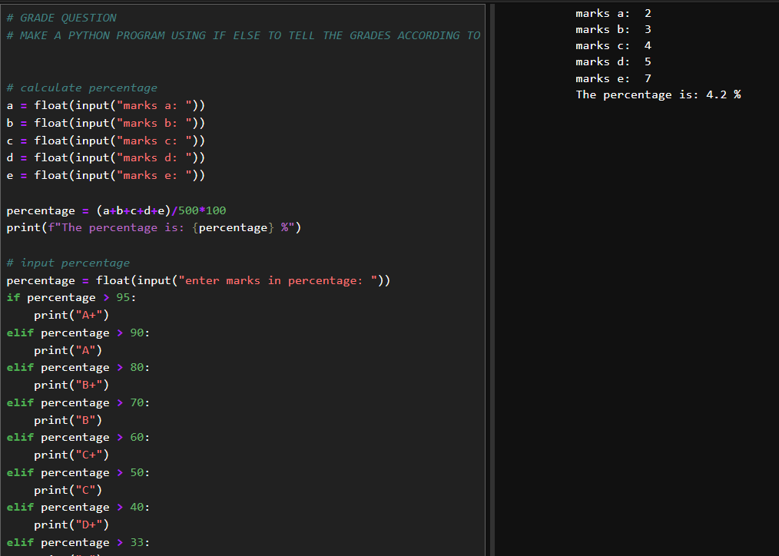
GRADING QUESTION

Slide 11
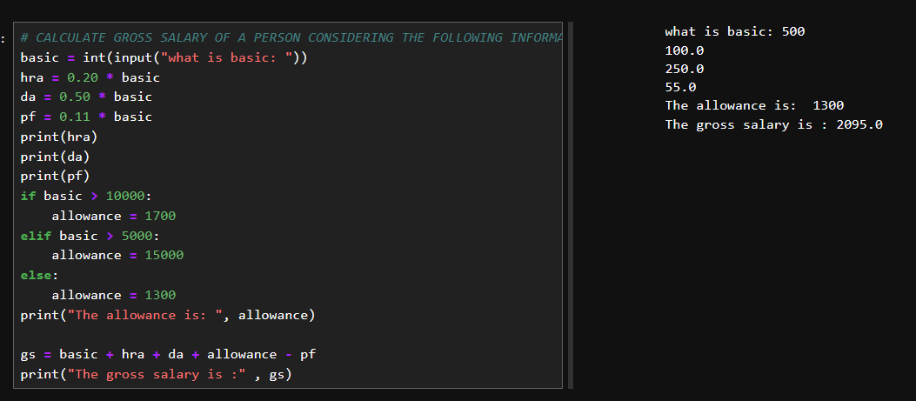
GROSS Salary

Slide 12
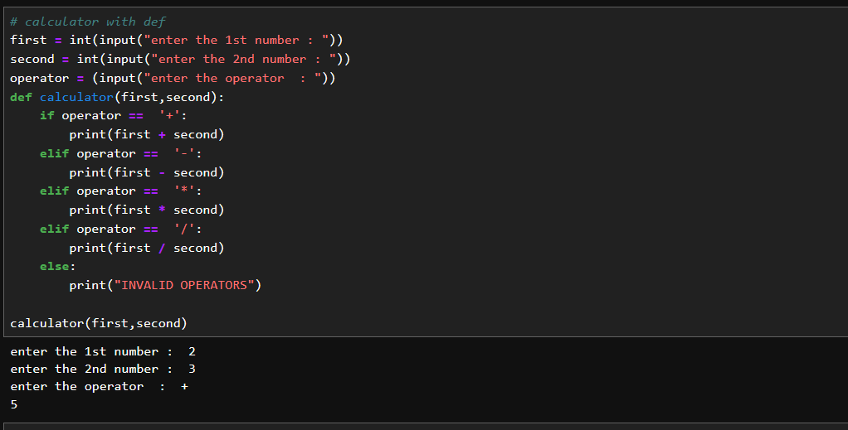
CALCULATOR

Slide 13
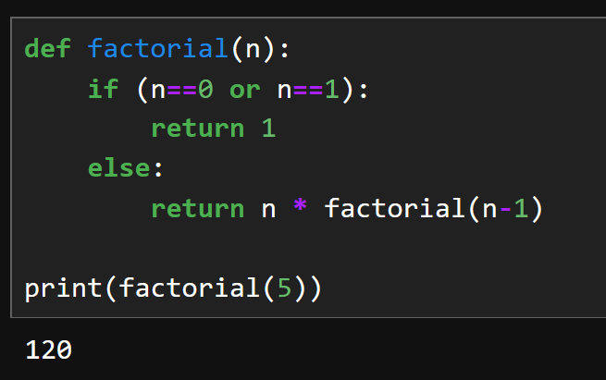
Factorial and Fibonacci Sequence

Slide 14
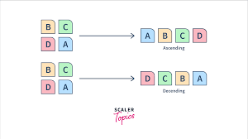
Sorting Techniques

Slide 15
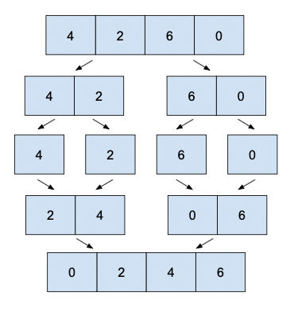
Merge Sort:
Concept: Divide array into halves, sort each half, and merge them.
Process:
  Divide: Split array into halves recursively.
  Conquer: Sort each subarray individually.
  Merge: Combine sorted subarrays into a single sorted array.
Quick Sort:
Concept: Choose a "pivot," partition array into elements smaller and larger than the pivot, then recursively sort partitions.
Process:
  Partition: Choose a pivot and rearrange elements around it.
  Conquer: Recursively sort smaller and larger partitions.
  Combine: No explicit combining step; sorting is done in place.
Divide and Conquer:
Approach: Break a problem into smaller, more manageable subproblems.
Process:
  Divide: Break the problem into smaller subproblems.
  Conquer: Solve each subproblem independently.
  Combine: Combine solutions of subproblems to solve the original problem.

Slide 16
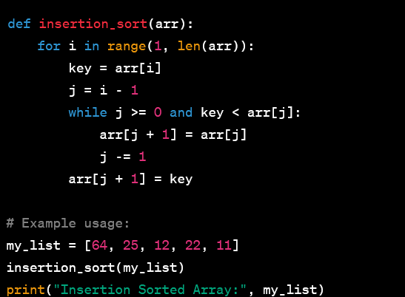
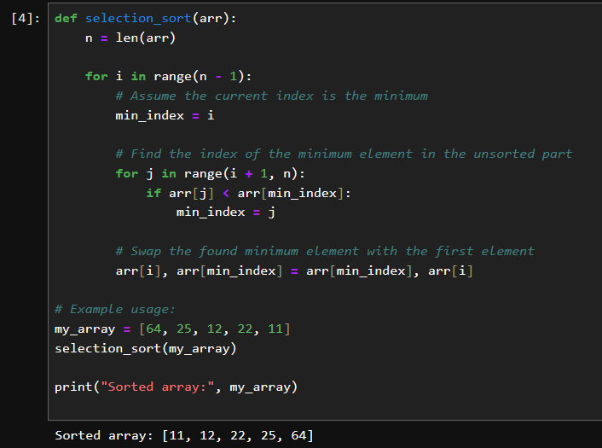
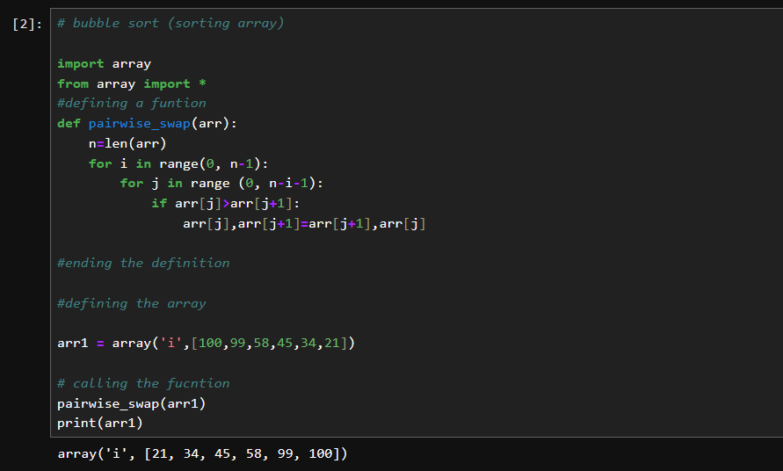
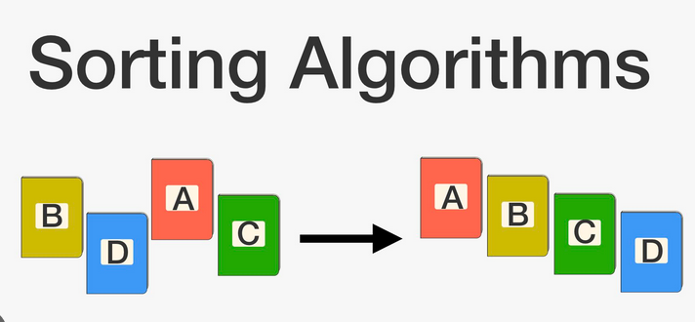

Slide 17
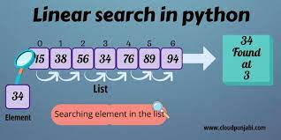

Slide 18
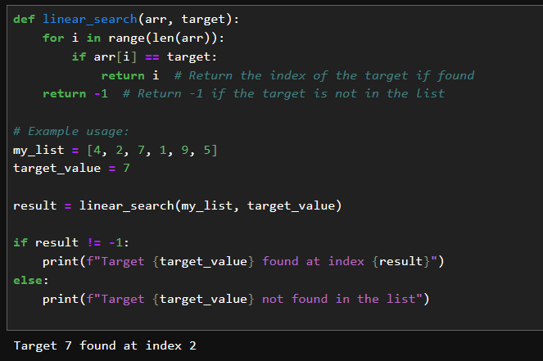
Linear search
, also known as sequential search, is a method for finding a target value within a list.

Slide 19
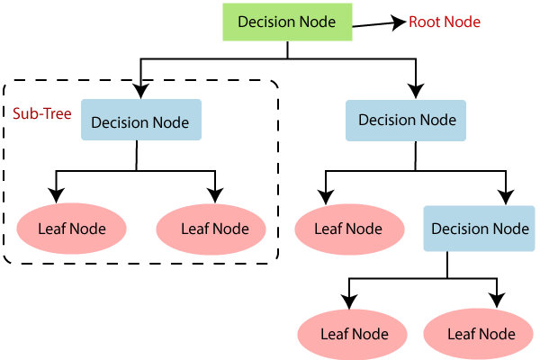
Decision tree
A decision tree is a predictive modeling technique used in machine learning and data mining. It recursively splits data based on feature conditions to make decisions or predictions.
t recursively divides a dataset into subsets based on the values of input features, creating a tree structure where each internal node represents a decision or a test condition, each branch represents the outcome of the test condition, and each leaf node represents the final decision or prediction. The process of constructing a decision tree involves selecting the most informative features at each step to maximize the discriminatory power of the tree.

Slide 20
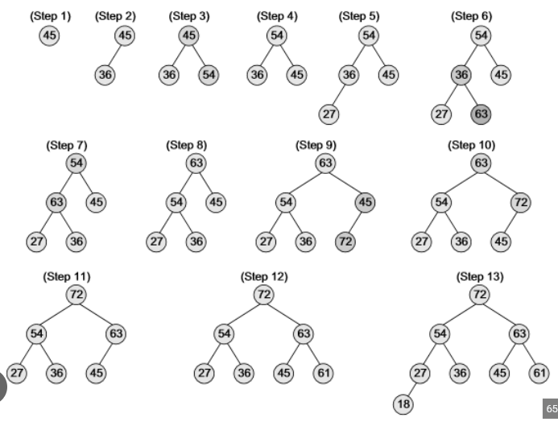
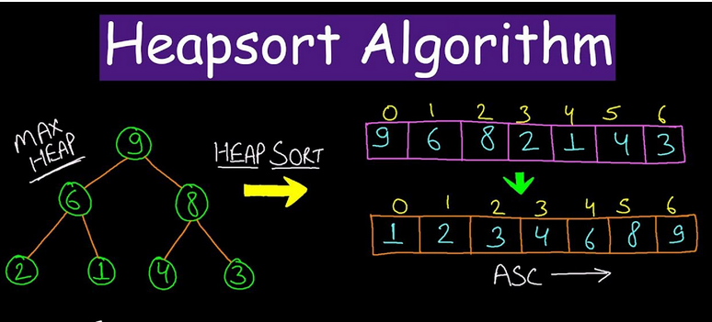
Heap Sort
Heap Sort is a comparison-based sorting algorithm that uses a binary heap data structure to sort elements in an array. It has the advantage of being an in-place sorting algorithm with an O(n log n) time complexity, making it efficient for large datasets.

Slide 21
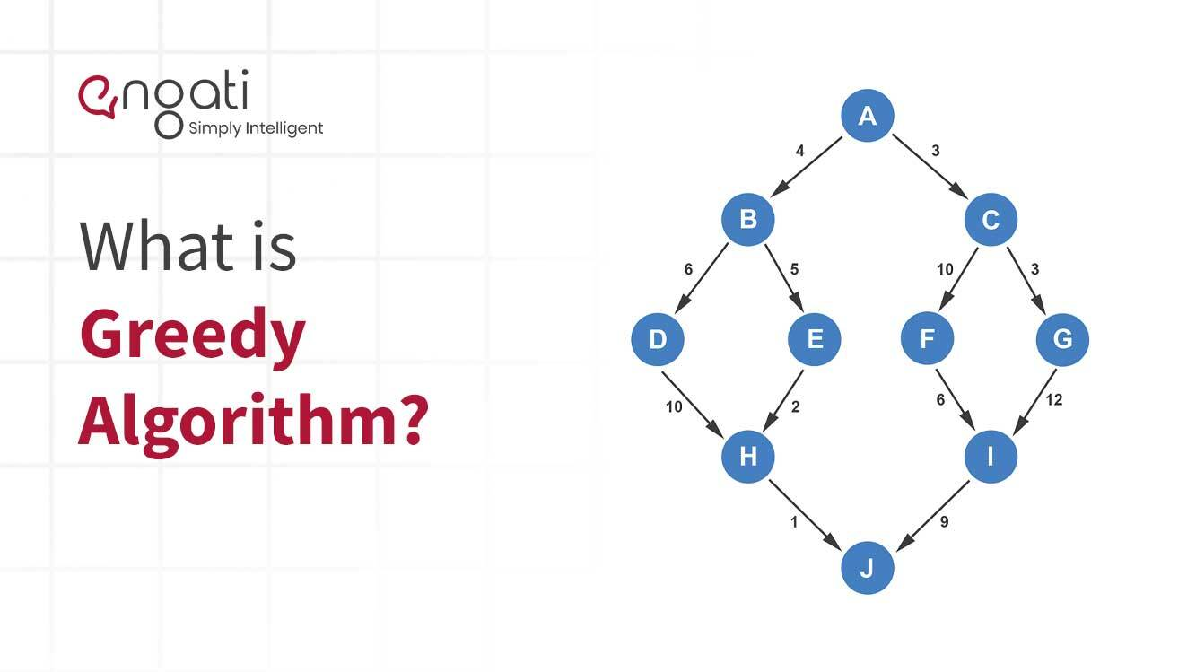
greedy algorithm
A greedy algorithm is an algorithmic paradigm that follows the problem-solving heuristic of making the locally optimal choice at each stage with the hope of finding a global optimum. In other words, a greedy algorithm makes the best possible decision at each step without considering the overall future consequences.
Key characteristics of greedy algorithms include:
Greedy Choice Property: At each step, the algorithm makes the choice that seems most promising in the current context. This choice is considered locally optimal.
Optimal Substructure: A problem exhibits optimal substructure if an optimal solution to the problem can be constructed from optimal solutions of its subproblems.
No Backtracking: Once a decision is made, it is never reconsidered. Greedy algorithms are generally incremental and do not revisit or revise previous choices.

Slide 22
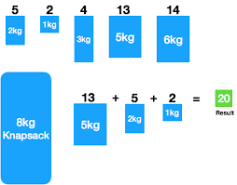
The Knapsack Problem
The Knapsack Problem is a classic optimization problem that can be solved using dynamic programming or greedy algorithms. The problem statement is as follows:
Problem Statement: Given a set of items, each with a weight and a value, determine the maximum value that can be obtained by selecting a subset of the items such that the sum of the weights of the selected items does not exceed a given capacity (knapsack capacity).
There are two main variations of the Knapsack Problem:
0/1 Knapsack Problem: In this variation, each item can either be selected (1) or not selected (0). You cannot take a fraction of an item.
Fractional Knapsack Problem: In this variation, you can take fractions of items, which means you can select a portion of an item.

Slide 23
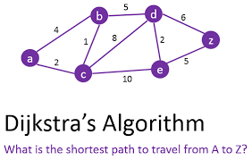
Dijkstra's Algorithm
Dijkstra's Algorithm is a popular algorithm used to find the shortest path between nodes in a graph, particularly in the context of weighted graphs where each edge has an associated non-negative weight.

Slide 24
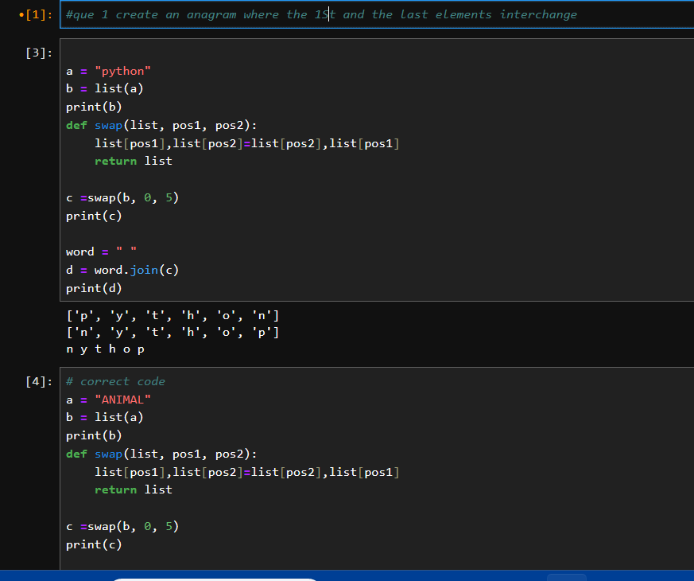
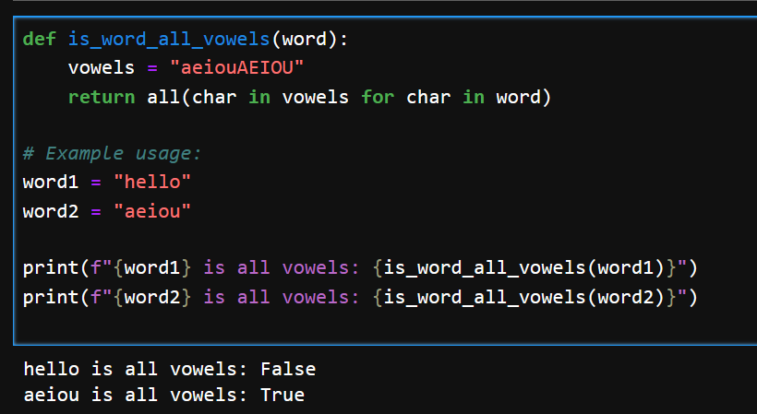
PROJECT 1 (ANAGRAM)
PROJECT 2 :
WORD IS VOWEL OR NOT

Slide 25
THANK YOU
THANK YOU

